Slide 1
Colored Items Sorter

Slide 2
Sorts the given input items based on color and as result items are grouped according to color in containers.
For demonstration we use Gems.
Technical part :

Slide 3
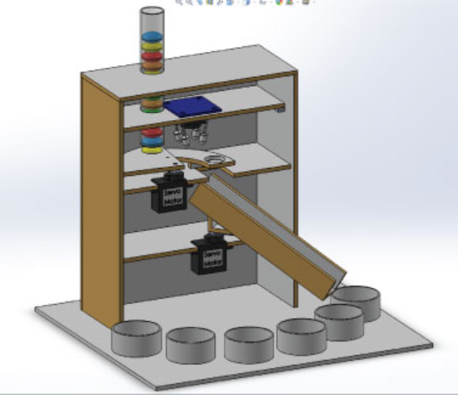

Slide 4
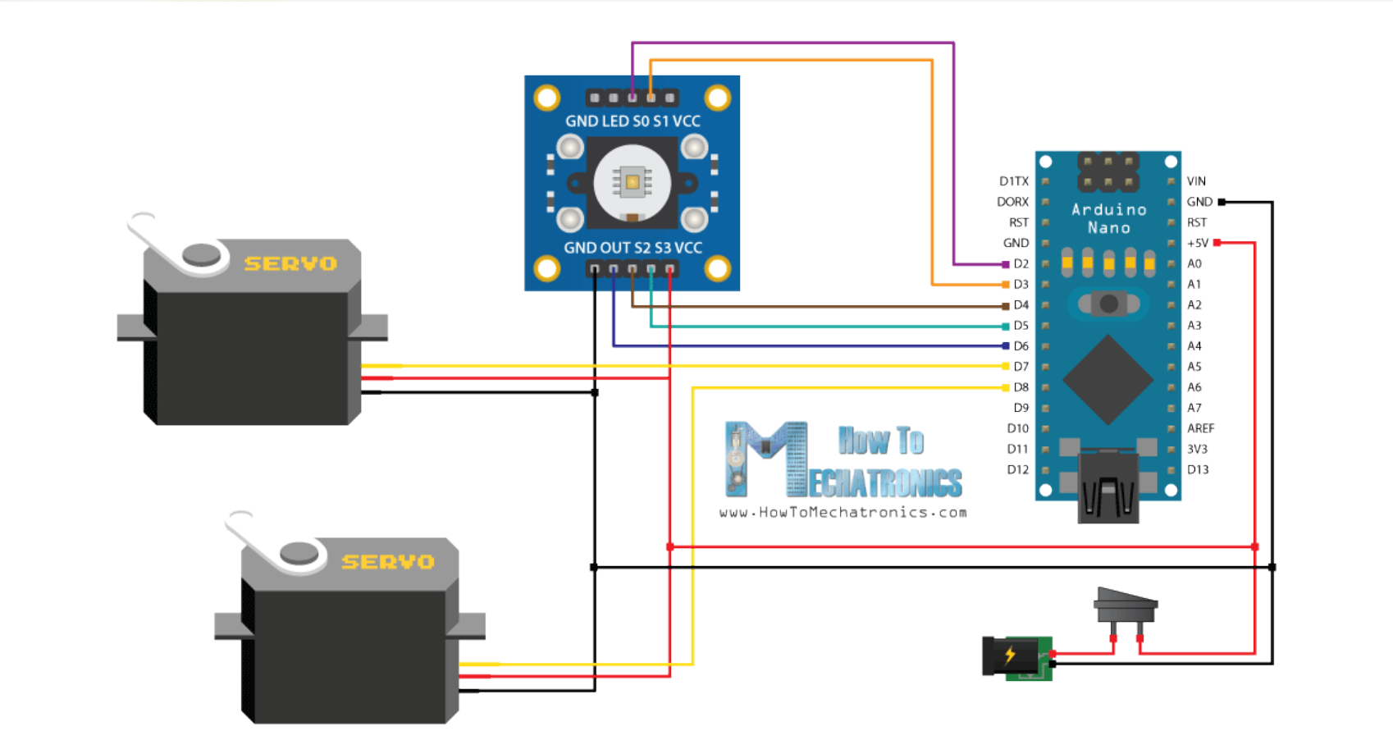

Slide 6
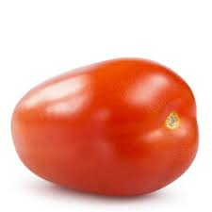
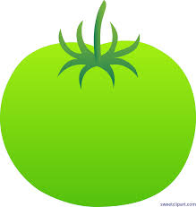
Application
Mainly in the field of agriculture to differentiate between fruits & vegetables.
  The tomato is ripe if color is RED and not ripe if GREEN.
  With better sensor quality,can determine if tomato has any blemishes.

Slide 7
Very efficient and cost-effective and works with minimum processing requirement.
Image processing implementation needs much more processing power and hardware.
Hence suitable for small scale business and farmers since only Arduino nano gets the job done.

